Slide 1
Team 5
Spatial, Temporal, and Weather Analysis of Accidents in Greater Nashville
BIG DATA FINAL PROJECT
Mark Raj, Daniel Zhang, Fateen Anam Rafid

Slide 2

Team 5
BIG DATA, Machine Learning, Artificial Intelligence
Mark Raj, Daniel Zhang, Fateen Anam Rafid
Spatial, Temporal, and Meteorological Analysis of Accidents in Greater Nashville

Slide 3
Data & Methods
Spatial Analysis
Geopandas to create spatial joins and create visualizations with plotly
Used linear regression to see demographic correlations with response time/accidents
Temporal Analysis
Conducted with Pandas and PlotLib to see year/month/time-of-day breakdowns
Meteorological Analysis
Joined minute-by-minute weather data to accident data using Spark/EMR, filtering for the closest weather stations
2 machine learning models to predict response time based on weather factors

Slide 4
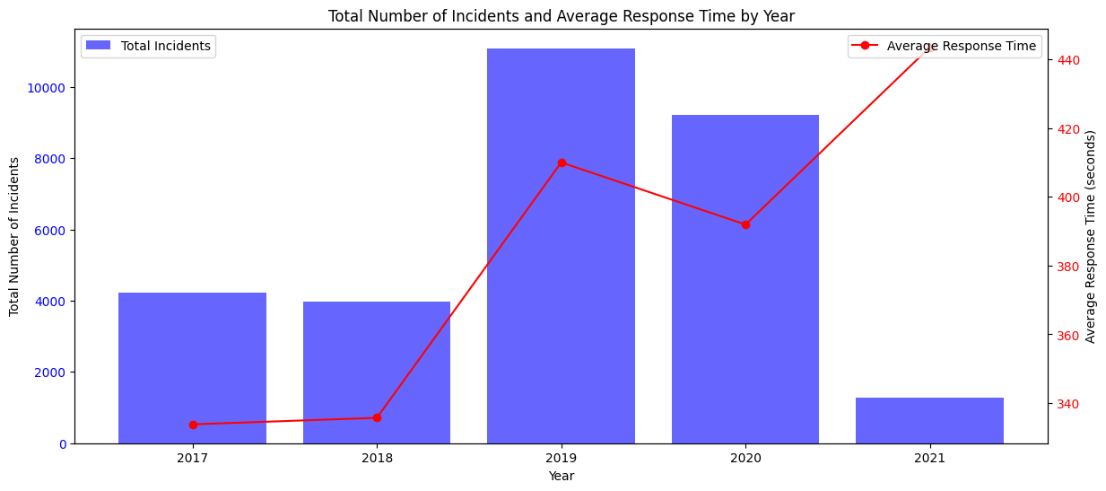
Temporal Analysis of Incidents
Key Takeaway:
Rise of Total Accidents over the Years.
Correlation can be seen with response time

Slide 5
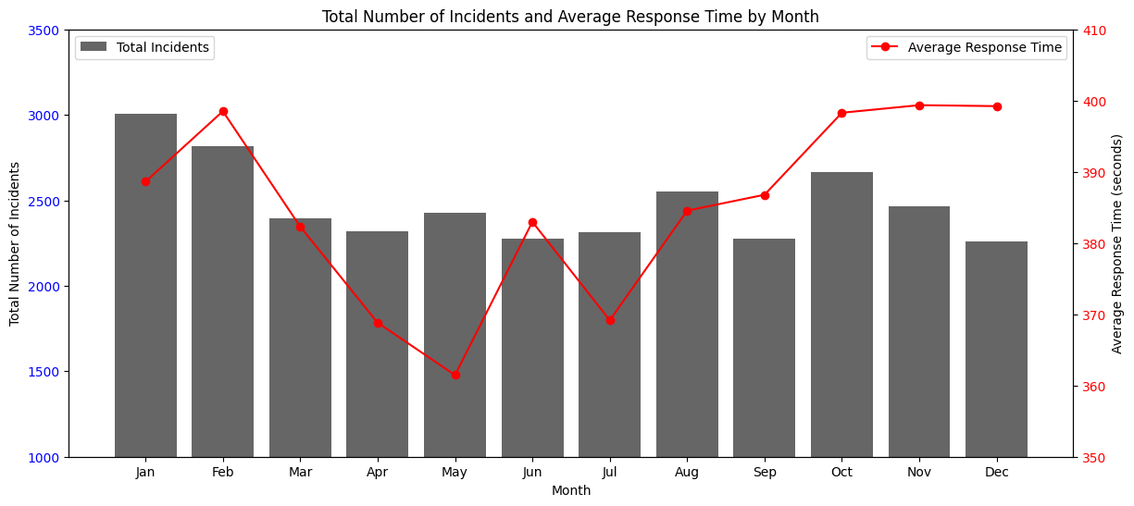
Temporal Analysis of Incidents
Key Takeaway:
Key Takeaway:
More Accidents happen during winter
Correlation can be seen between total incidents response time

Slide 6
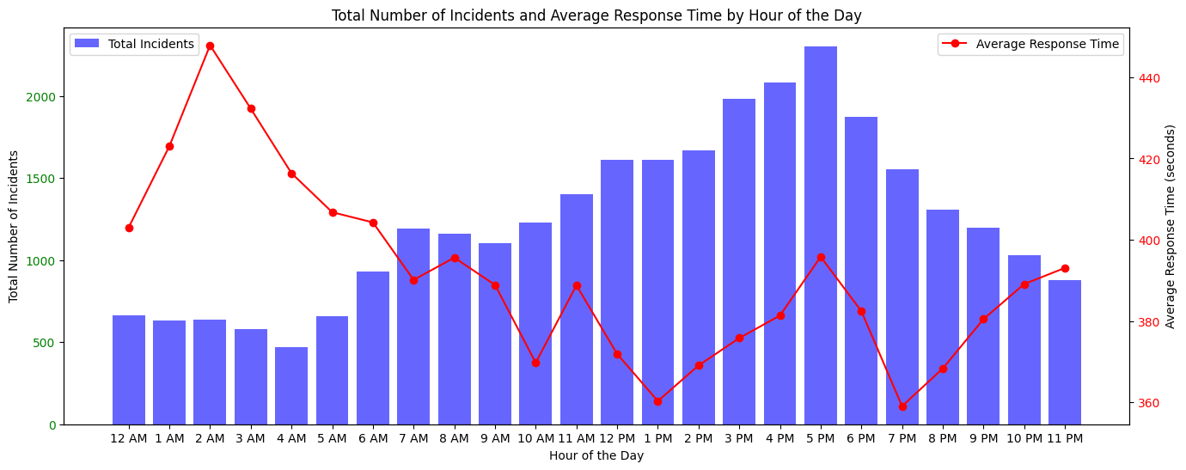
Temporal Analysis of Incidents
Key Takeaway:
More accidents happen during the day
Response time is higher after midnight. Inverse correlation.

Slide 7
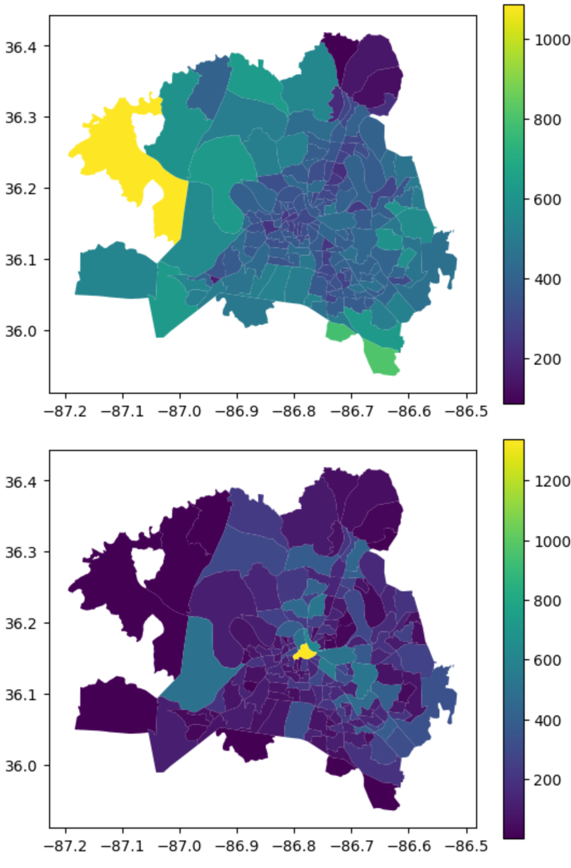
Spatial Analysis of Incidents
Number of Incidents
Average Response Time

Slide 8
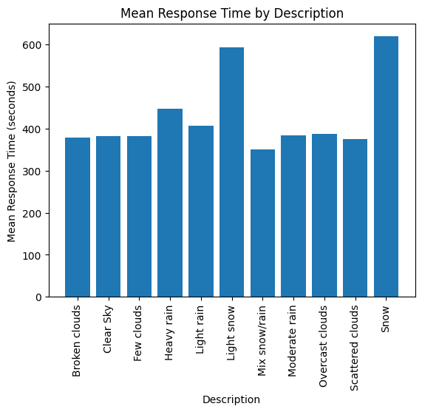
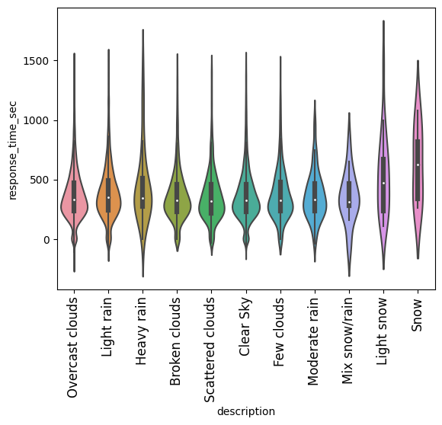
Meteorological Analysis of Incidents

Slide 9
Meteorological Analysis of Incidents
Machine Learning
Random Forest
RMSE: 156 seconds
R² = 0.04
Gradient Boosting
RMSE: 54191 seconds
R² = 0.09
Prioritized location and time over weather

Slide 10
Conclusions
The primary focus for government should be on spatial disparities between areas of Nashville, contributing to longer response times
Investments in weather-resistant systems would prove useful in lowering response times, including evenly distributing these systems throughout Nashville
Incident frequency has a strong relationship with time-based metrics and local government should use time-based smart suggestions to keep ahead

Slide 11
Bibliography
Pettet, G., Nannapaneni, S., Stadnick, B., Dubey, A., & Biswas, G. (2017, August). Incident analysis and prediction using clustering and bayesian network. In 2017 IEEE SmartWorld, Ubiquitous Intelligence & Computing, Advanced & Trusted Computed, Scalable Computing & Communications, Cloud & Big Data Computing, Internet of People and Smart City Innovation (SmartWorld/SCALCOM/UIC/ATC/CBDCom/IOP/SCI) (pp. 1-8). IEEE.
Soni, A. (2018). Violin plots explained. Towards Data Science. https://towardsdatascience.com/violin-plots-explained-fb1d115e023d

